Slide 1
recap
Objectives:
re-run biological process and molecular function dmm models
Attempt to subset to only a higher depth
We had an issue with the names…

Slide 2
Biological process visualizations
Jochum, Michael D.
9 November 2020

Slide 3
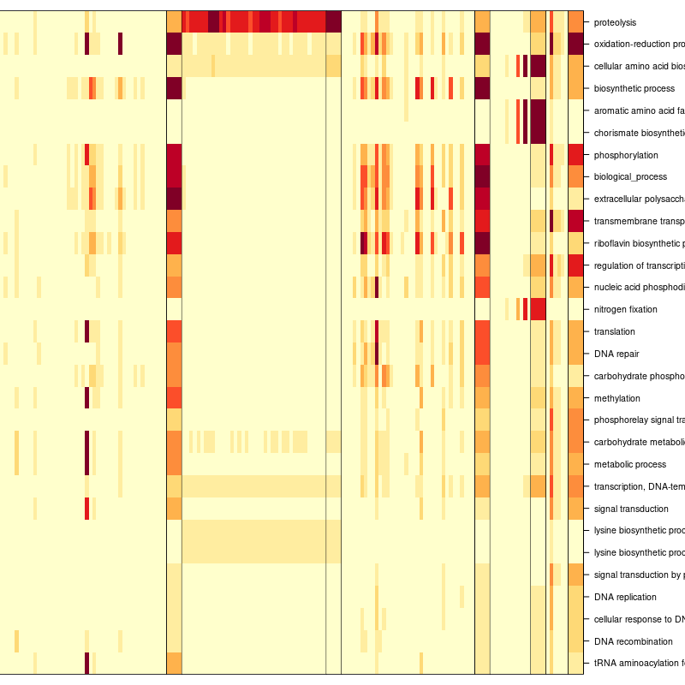

Slide 4
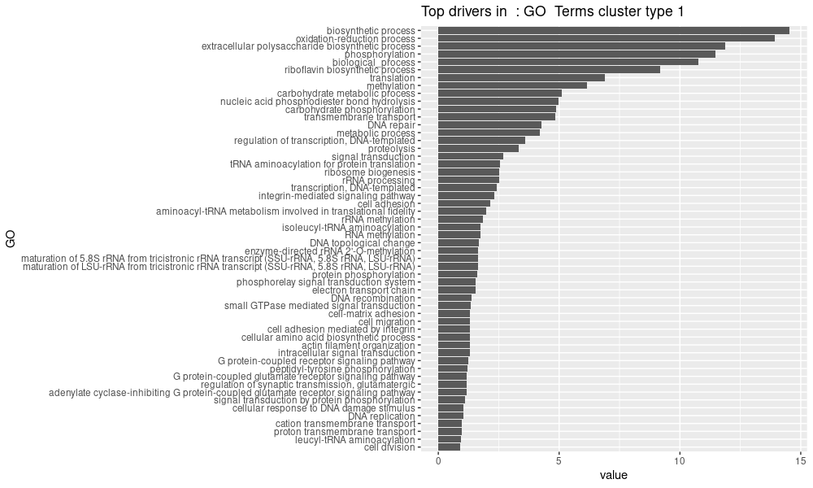
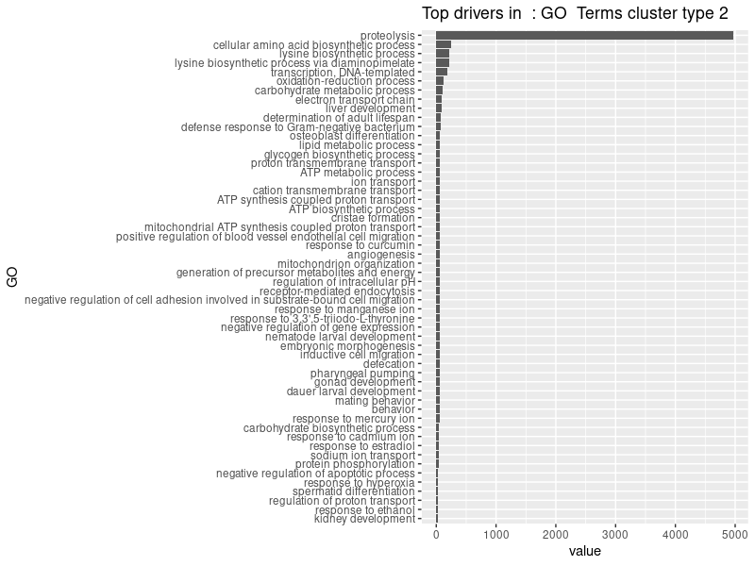
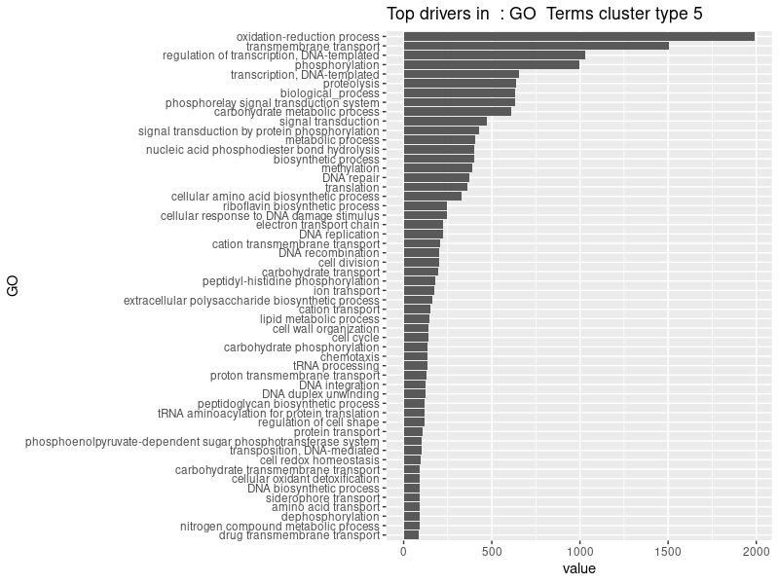
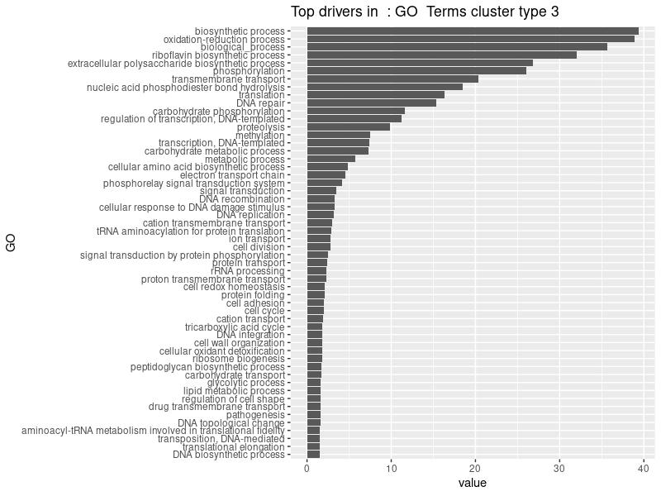
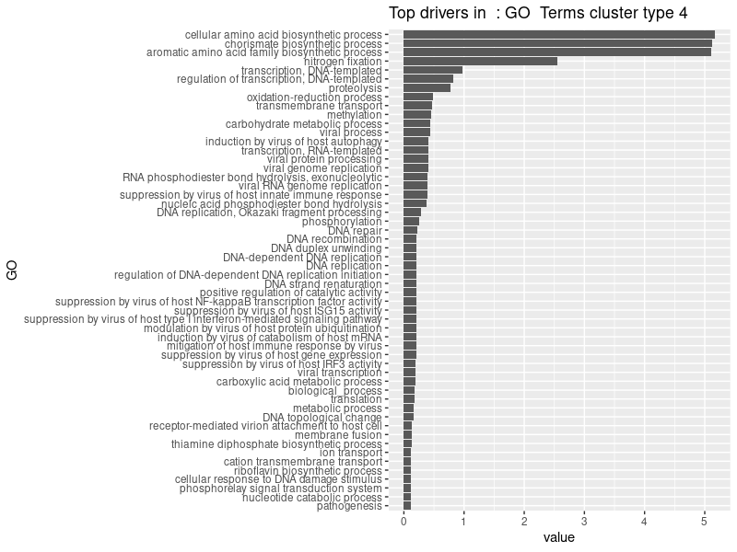

Slide 6
Molecular function visualizations
Jochum, Michael D.
9 November 2020

Slide 7
Bubble plots of samples vs dmm cluster vs disease for molecular functions with depth > 10
Pre- processing GO_Terms
Pre-processing Steps Taken | Go Term (n) | samples
Subset for biological processes only | 4236 | 167
Removed neg control and Unknown sample types | 4236 | 141
Removed Go terms and samples with summation < 10 | 3504 | 136
Agglomerated Go_terms by name | 3477 | 136
Remove all molecular function with depth < level 10 | 50 | 136
Remove all sample with < 0 terms remaining | 50 | 122
Remove all sample with < 0 terms remaining | 50 | 71
Fast, but
not enough resolution…

Slide 8
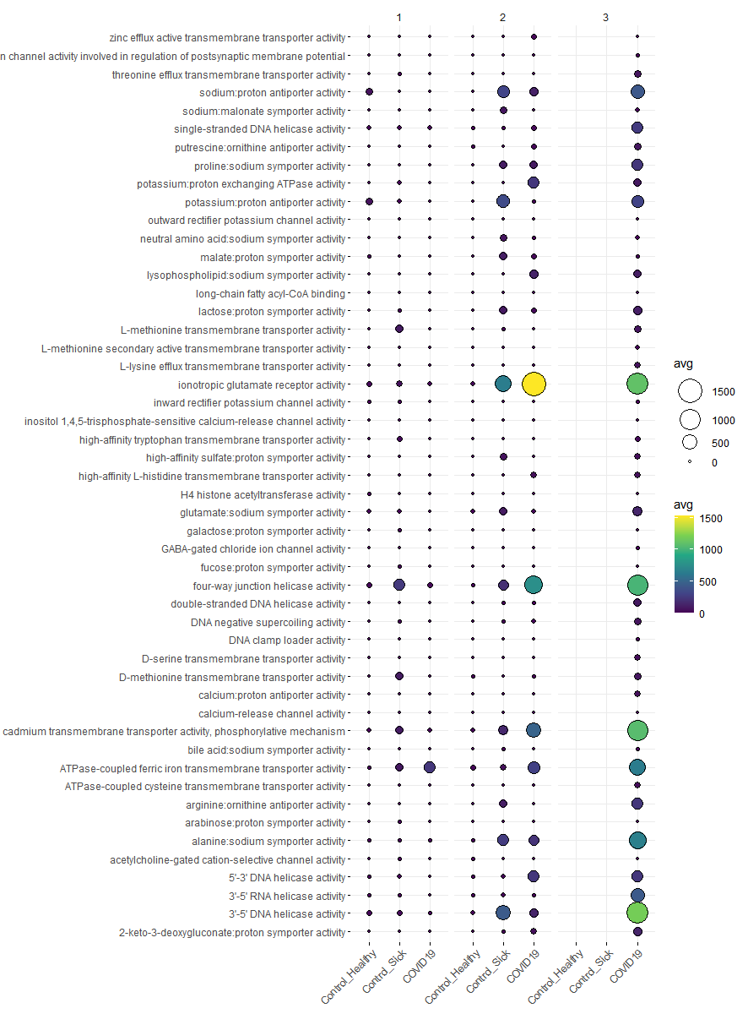
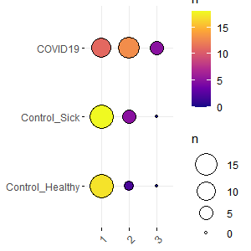
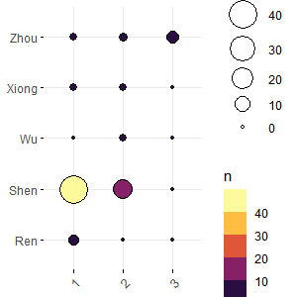
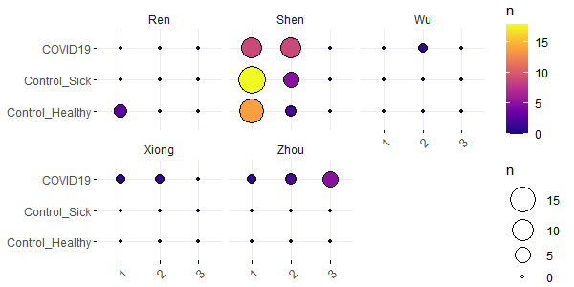
Bubble plots of samples vs dmm cluster vs disease for molecular functions with depth > 10

Slide 9
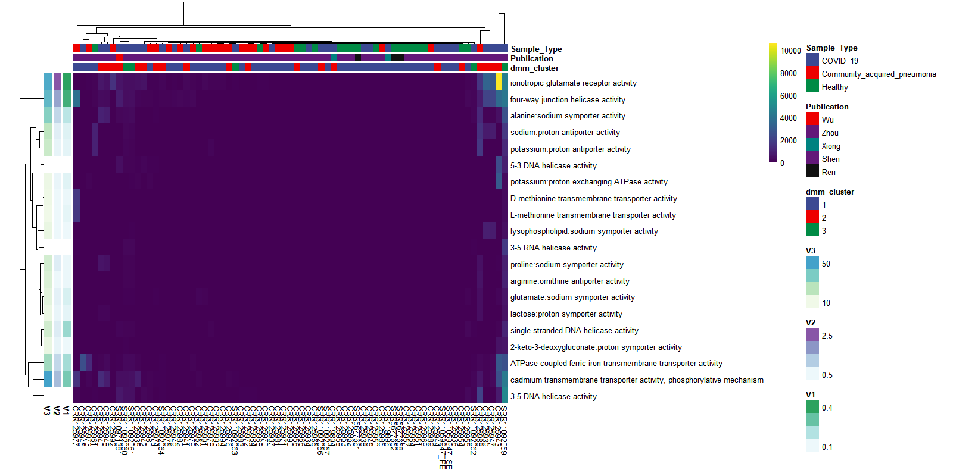
Heatmap of molecular functions with depth > 10

Slide 10
Bubble plots of samples vs dmm cluster vs disease for molecular functions with depth > 10
Pre-processing Steps Taken | Go Term (n) | samples
Subset for biological processes only | 4236 | 167
Removed neg control and Unknown sample types | 4236 | 141
Removed Go terms and samples with summation < 10 | 3504 | 136
Agglomerated Go_terms by name | 3477 | 136
Remove all molecular function with depth < level 8 | 2386 | 136
Remove all sample with < 0 terms remaining | 2386 | 134
# of bioprocesses
 | dmm cluster
case | 1 | 2 | 3 | 4 | 5 | Total
Control_Healthy | 69194 | 7158 | 0 | 0 | 0 | 76352
Control_Sick | 28632 | 85896 | 26246 | 4772 | 0 | 145546
COVID19 | 38176 | 0 | 23860 | 21474 | 14316 | 97826
Total | 136002 | 93054 | 50106 | 26246 | 14316 | 319724

Slide 11
kruskal_wallis_test_mol_fxn | obs.tot | obs.groups | df | statistic | pvalue
3-dehydroquinate dehydratase activity | 134 | 3 | 2 | 58.14207 | 2.37E-13
guanyl-nucleotide exchange factor activity | 134 | 3 | 2 | 50.94694 | 8.65E-12
growth factor activity | 134 | 3 | 2 | 47.10921 | 5.89E-11
voltage-gated anion channel activity | 134 | 3 | 2 | 46.73641 | 7.10E-11
retinal binding | 134 | 3 | 2 | 46.70329 | 7.22E-11
bile acid binding | 134 | 3 | 2 | 45.80384 | 1.13E-10
3-chloroallyl aldehyde dehydrogenase activity | 134 | 3 | 2 | 43.44821 | 3.68E-10
GTPase activity | 134 | 3 | 2 | 41.63407 | 9.10E-10
retinal dehydrogenase activity | 134 | 3 | 2 | 41.58573 | 9.33E-10
GTP binding | 134 | 3 | 2 | 41.44649 | 1.00E-09
proton-transporting ATPase activity, rotational mechanism | 134 | 3 | 2 | 41.34968 | 1.05E-09
diaminopimelate decarboxylase activity | 134 | 3 | 2 | 41.13356 | 1.17E-09
aldehyde dehydrogenase [NAD(P)+] activity | 134 | 3 | 2 | 40.43644 | 1.66E-09
retinol dehydrogenase activity | 134 | 3 | 2 | 40.37158 | 1.71E-09
ADP binding | 134 | 3 | 2 | 40.03891 | 2.02E-09
alkali metal ion binding | 134 | 3 | 2 | 37.38552 | 7.62E-09
betaine-aldehyde dehydrogenase activity | 134 | 3 | 2 | 37.09107 | 8.83E-09
benzaldehyde dehydrogenase (NAD+) activity | 134 | 3 | 2 | 36.91322 | 9.65E-09
phenylacetaldehyde dehydrogenase activity | 134 | 3 | 2 | 36.5841 | 1.14E-08
NADH binding | 134 | 3 | 2 | 36.36626 | 1.27E-08
glyceraldehyde-3-phosphate dehydrogenase (NAD+) (non-phosphorylating) activity | 134 | 3 | 2 | 36.04852 | 1.49E-08
MHC class I protein binding | 134 | 3 | 2 | 35.58412 | 1.88E-08
poly(U) RNA binding | 134 | 3 | 2 | 35.49184 | 1.96E-08

Slide 12
Go term visualizations
Jochum, Michael D.
2 November 2020

Slide 13
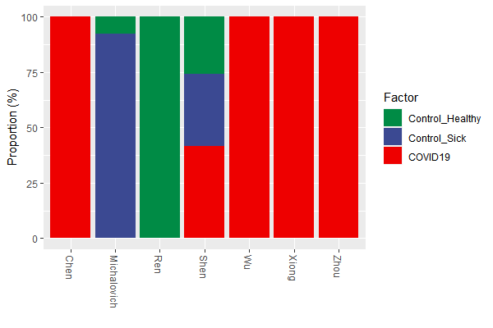
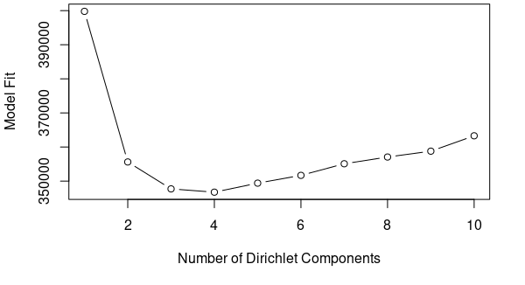
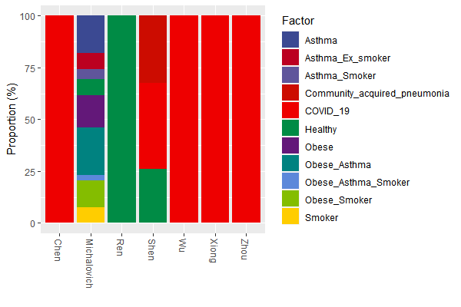
Pre- processing GO_Terms
Pre-processing Steps Taken | Go Term (n) | samples
Subset for biological processes only | 3393 | 167
Removed neg control and Unknown sample types | 3393 | 141
Removed Go terms and samples with summation < 10 | 2212 | 134
Agglomerated Go_terms by name | 2107 | 134
DMM model fit

Slide 14
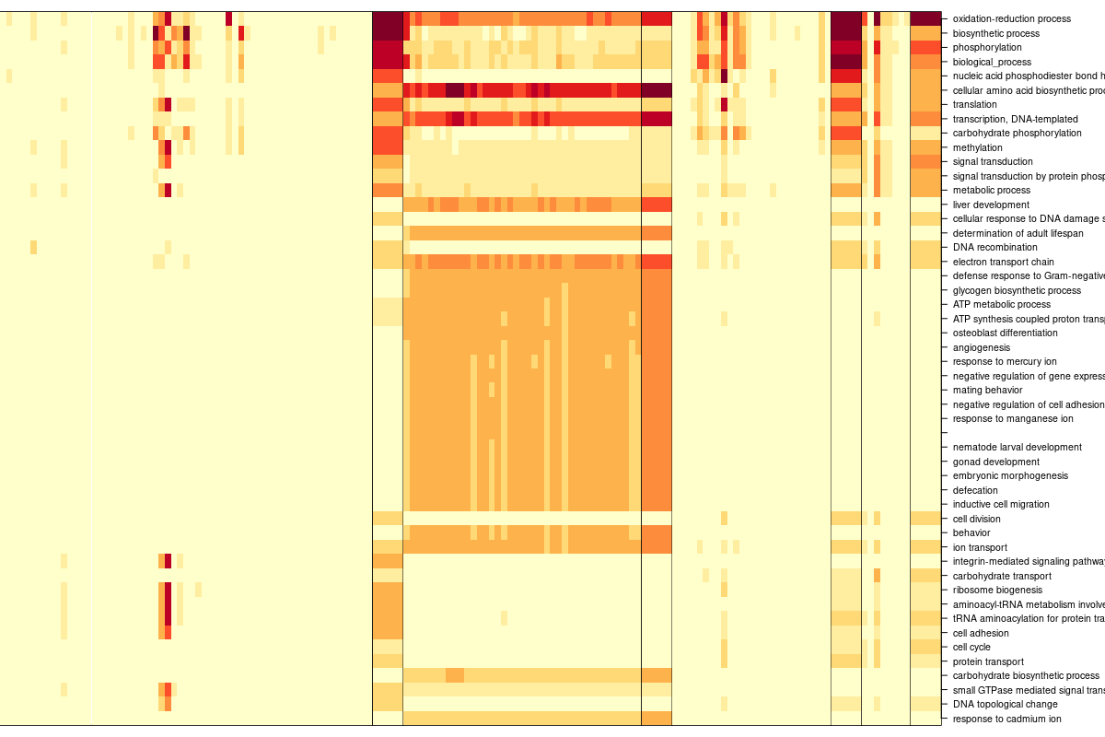
Square root transformed Dirichlet Multinomial Mixtures Community typing (k=4)

Slide 15
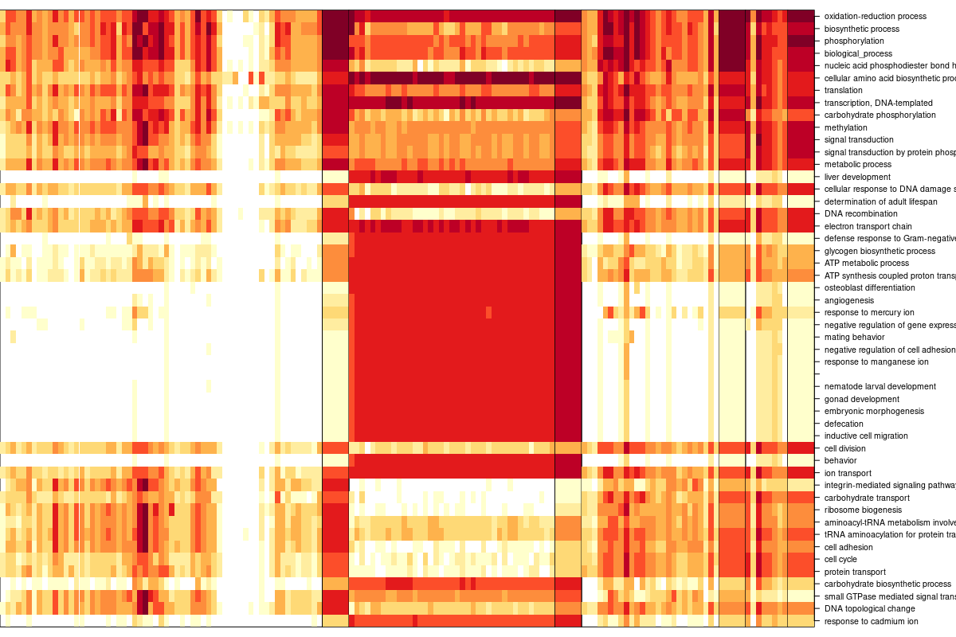
Log 2 Dirichlet Multinomial Mixtures Community typing (k=4)

Slide 16
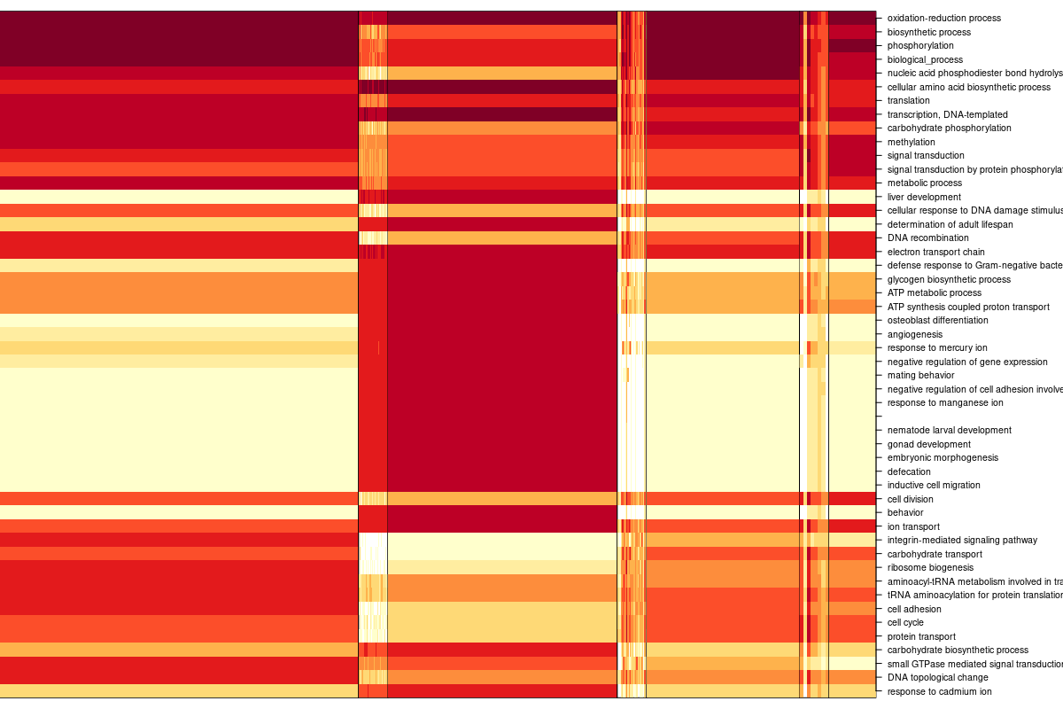
Log 10 Dirichlet Multinomial Mixtures Community typing (k=4)

Slide 17
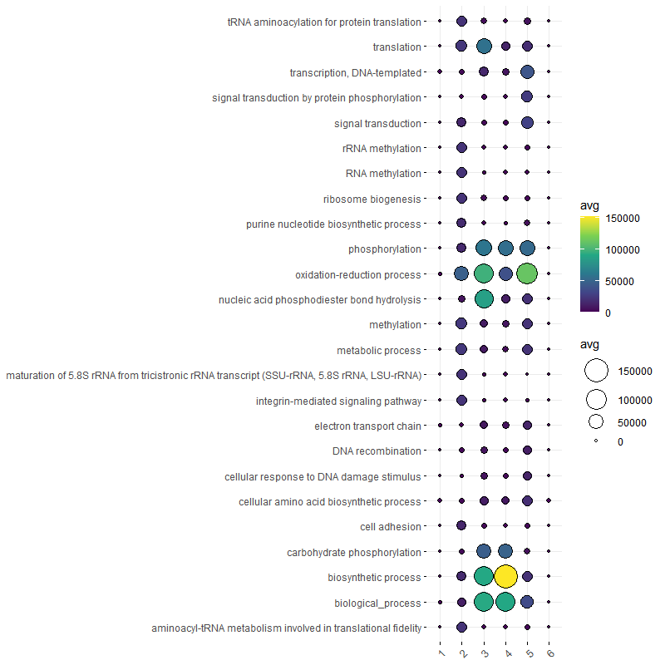
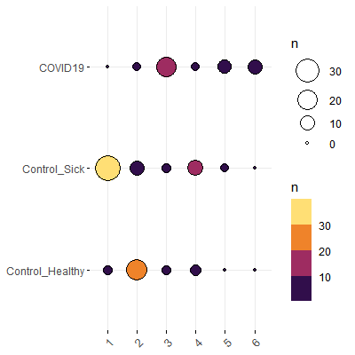
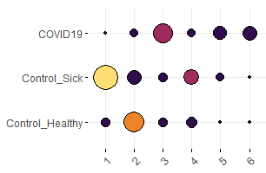
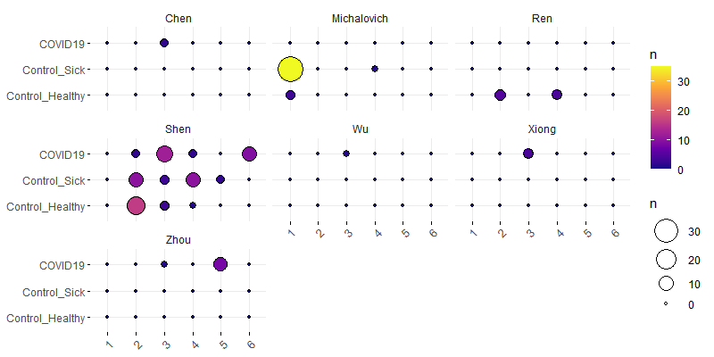
Bacteria derived biological process GO term Dirichlet Multinomial Mixtures Community typing (k=6)
DMM group (x) by case (y), colored by count
DMM group (x) by case (y) faceted by publication, colored by count

Slide 18
OLD STUFF Go term visualisations
Jochum, Michael D.
27 Oct 2020

Slide 19
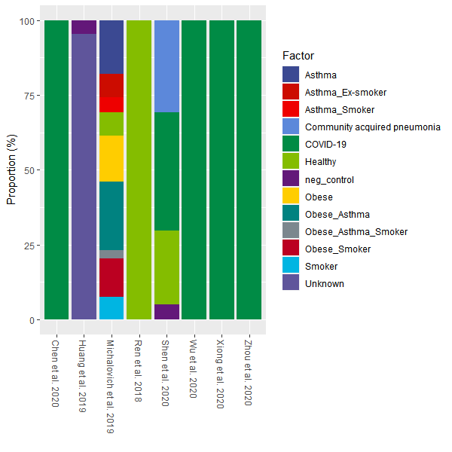
Proportion of samples types by publication

Slide 20
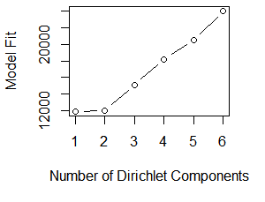
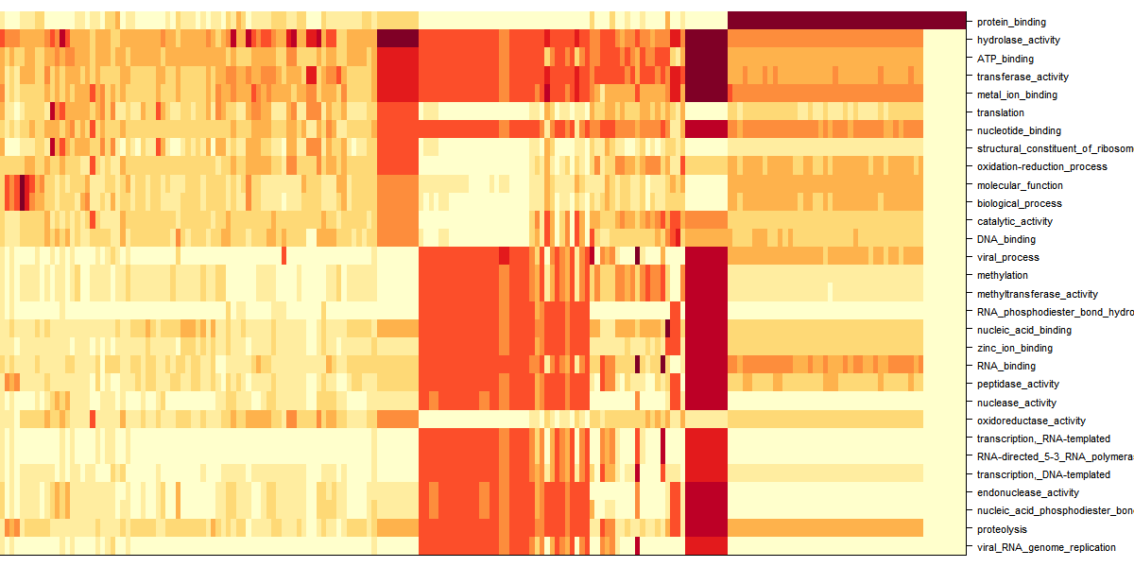
Dirichlet Multinomial Mixtures Community typing

Slide 21
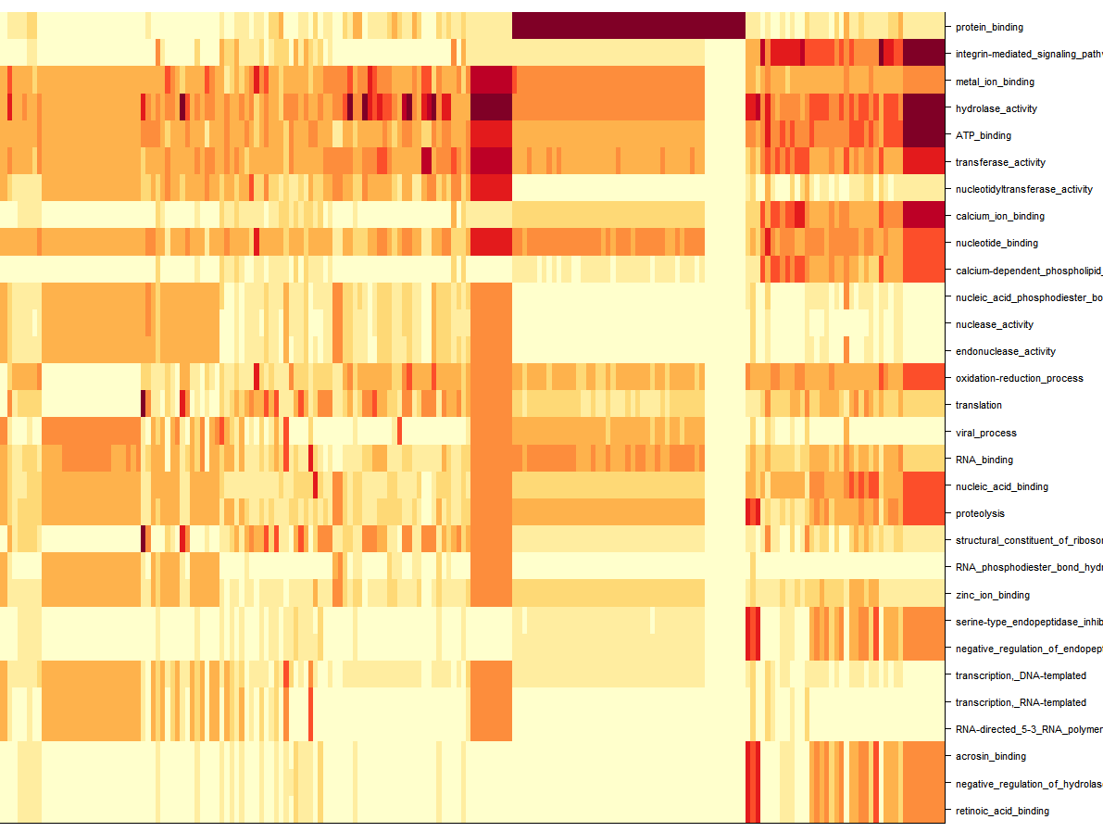
Dirichlet Multinomial Mixtures Community typing

Slide 22
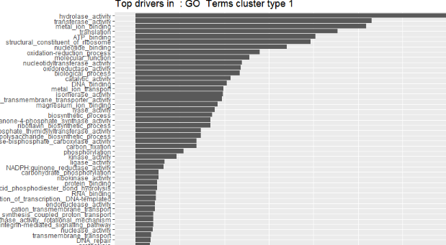
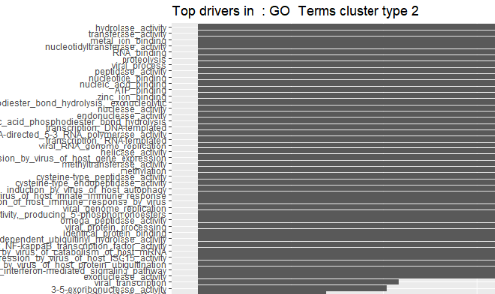
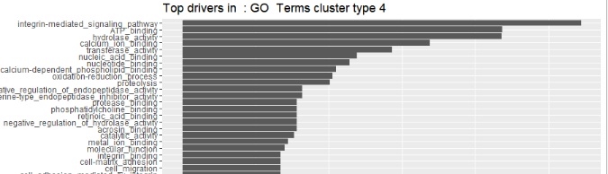
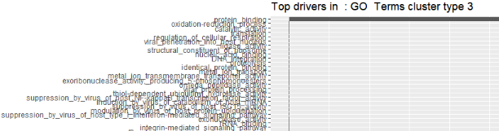
Dirichlet Multinomial Mixtures Community typing

Slide 23
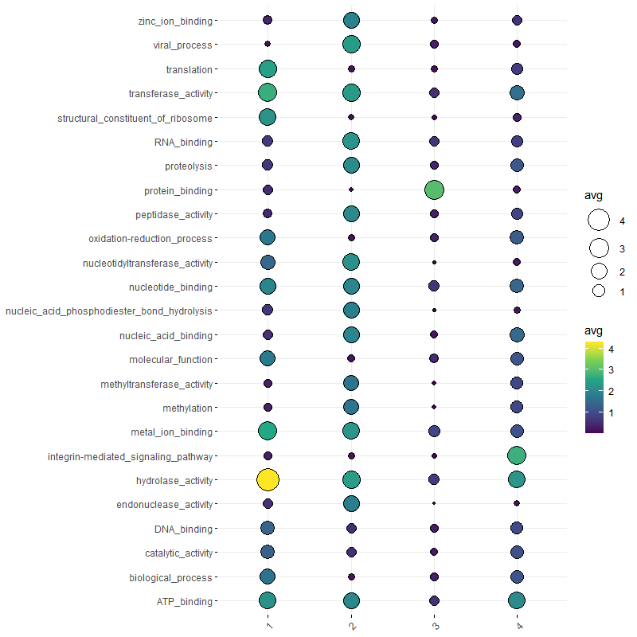
Dirichlet Multinomial Mixtures Community typing

Slide 24
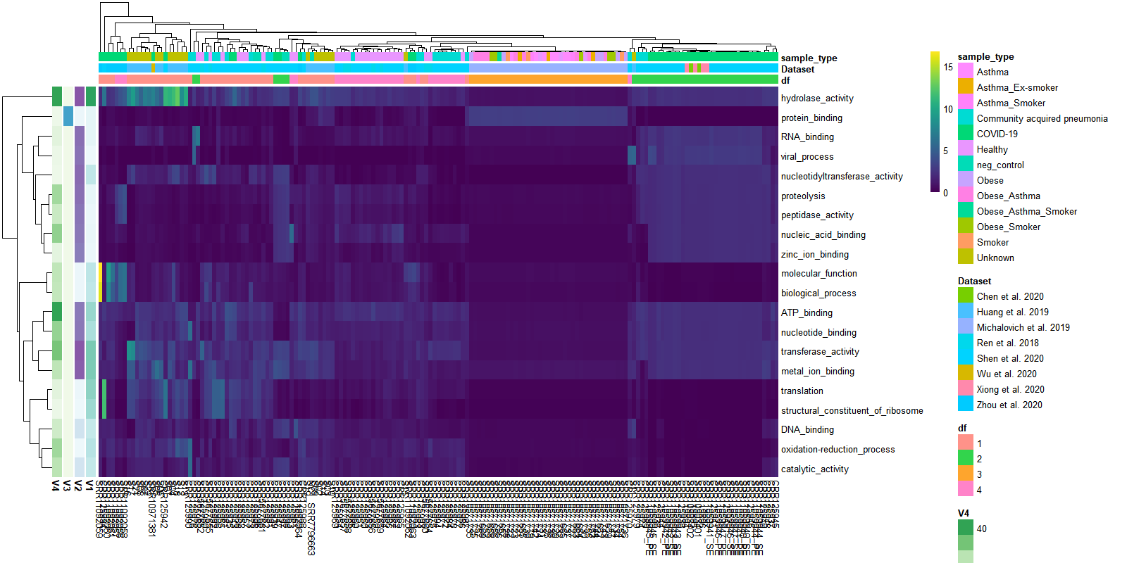
Dirichlet Multinomial Mixtures Community typing

